Slide 1
Sboot - µTZVisor
Embedded Systems
Ailton Lopes – A72852
Jose Oliveira – A65354
Advisors: Adriano Tavares
Sandro Pinto

Slide 2
Agenda
Problem Statement
Hypervisor
State of Art
Requirements
Constraints
Gantt Diagram

Slide 3
Problem Statement
Nowadays malware developers turned their attention to the firmware that runs before the operating system, using Rootkits to install malware or change the image of the software of the secure world the hacker can get full access of the entire system.

Slide 4
Problem Statement
A System without any techniques to verify the authenticity of the images that are being executed is vulnerable to this kind of attack.
That’s why we need to implement the Secure Boot.

Slide 5
Hypervisor
Hypervisor or Virtual Machine Monitor (VMM)
It’s a software or firmware that abstracts and isolates Operating System (OS) from the hardware.
The abstraction allows us to run in the same machine (host machine) different OS (guest machine) that share the physical resources of the host machine

Slide 6
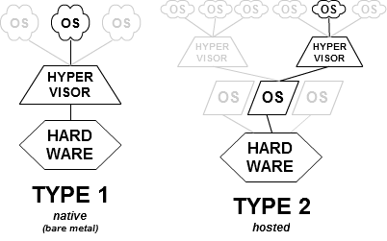
Hypervisor
Types of Hypervisor

Slide 7
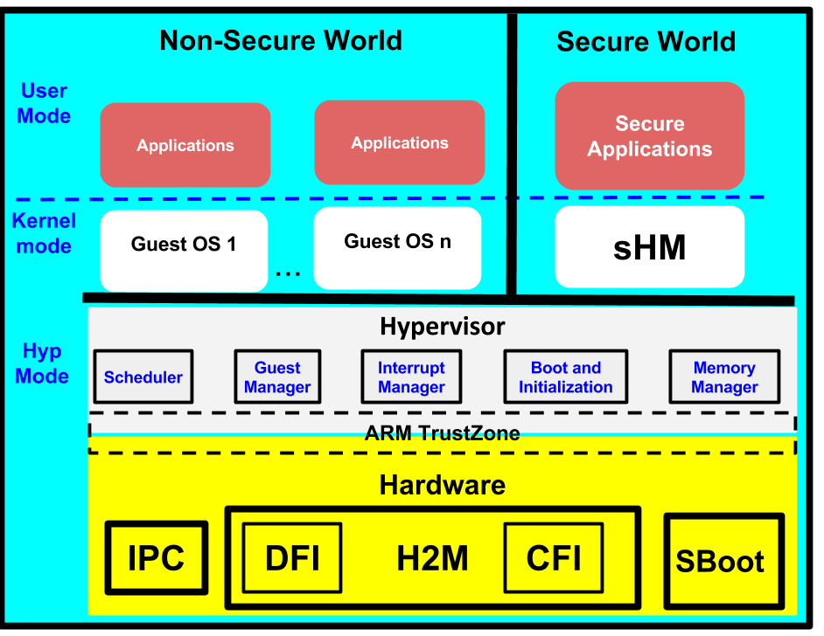
µTZvisor Overview

Slide 8
Secure Boot
One of the principles used to implement the Secure boot is the creation of the Chain of Trust for all the softwares of the Secure World
Notes:
Usando criptografia de chave pública para verificar que cada parte do firmware foi assinada digitalmente e não foi modificada assim que o sistema iniciar. Assim que uma parte for validada, a próxima será verificada e assim sucessivamente.

Slide 9
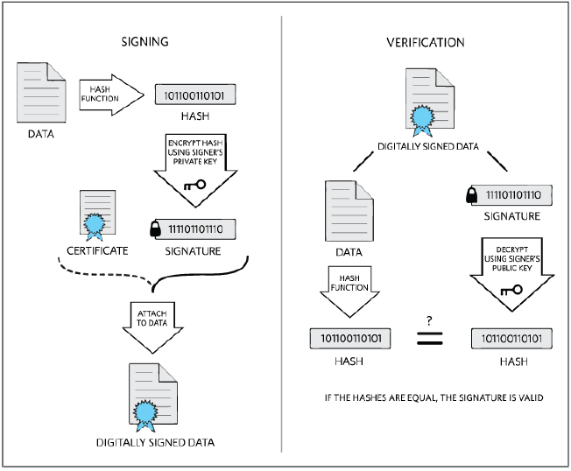
Data Signing and verification
Notes:
Usando criptografia de chave pública para verificar que cada parte do firmware foi assinada digitalmente e não foi modificada assim que o sistema iniciar. Assim que uma parte for validada, a próxima será verificada e assim sucessivamente.

Slide 10
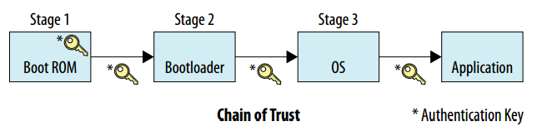
Chain of trust
The beginning of the Chain of Trust (Root of Trust) requires a strong foundation, has to be robust in order to guarantee the integrity of the Secure Boot.

Slide 11
Aims
The secure boot aims to guarantee the integrity and authenticity of all the images executed in the Secure World, by allowing only the execution of the images with a valid signature.

Slide 12
State of the Art
NIST Guidelines
NIST 800-147
NIST 800-155
The NIST guidelines provide a framework designed to keep the firmware from being improperly modified.

Slide 13
State of the Art
Considering the importance of the secure boot in modern embedded systems, major SoC manufacturer have begun to implement mechanisms that provide the embedded system developer ways implement a hardware-based root of trust.
Intel Boot Guard
AMD Platform Security Processor
ARM TrustZone
Notes:
Original equipament manufactures

Slide 14
Requirements
Functional:
Guarantee the authenticity and integrity of the image or firmware that are being executed.
Guarantee the confidentiality of the primary key used in the software signing.
Implement a robust Root of Trust image.
Non-Functional:
Compatible with the Zybo Board
Notes:
Restricoes

Slide 15
Constraints
Technical:
Use the Xilinx Vivado Design Suite to develop and implement the verilog code.
Use the SDK to compile the C code, generate and load the boot image.
Use the SDK to debug the software and the hardware.
Non-Technical:
Group composed by two elements.
6 hours of work per week for each element of the group
Notes:
Restrições

Slide 16
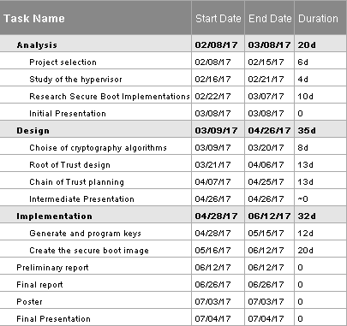
Tasks

Slide 17

Gantt Diagram

Slide 18
References
[1] T. Begins, R. Secure, and H. Root, “Secure IoT System Boot with a hardware Root of Trust Design Ware tRoot Secure Hardware Root of Trust Hardware ­ Enforced Secure Boot with tRoot,” pp. 1–3, 2016.
[2] S. Expert and M. Integrated, “Application Note 6004 Secure the Iot : Part 1 , Public Key Cryptography,” pp. 1–9.
[3] B. Y. Loisel, S. Architect, S. Vito, S. Expert, and M. Integrated, “Application Note 6005 Secure the Iot : Part 2 , a Secure Boot , the ‘ Root of Trust ’ for Embedded Devices,” pp. 1–9.
[4] R. Wilkins and D. Ph, “The chain of trust,” no. June, 2016.
[5] V. Zimmer and M. Krau, “Establishing the root of trust,” no. August, 2016.

Slide 19

Questions?

